Slide 1

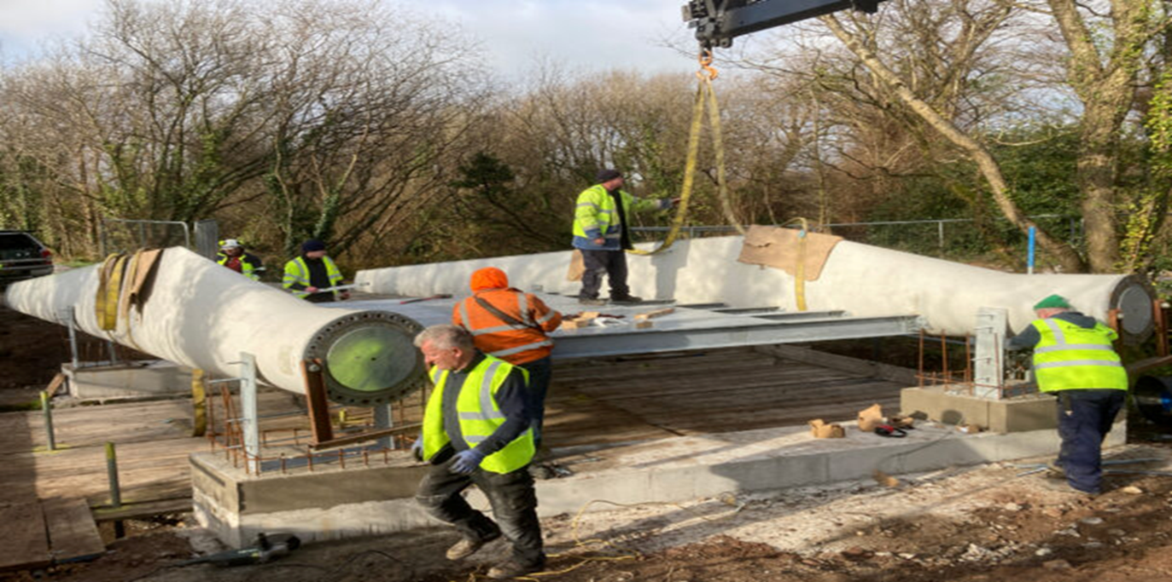
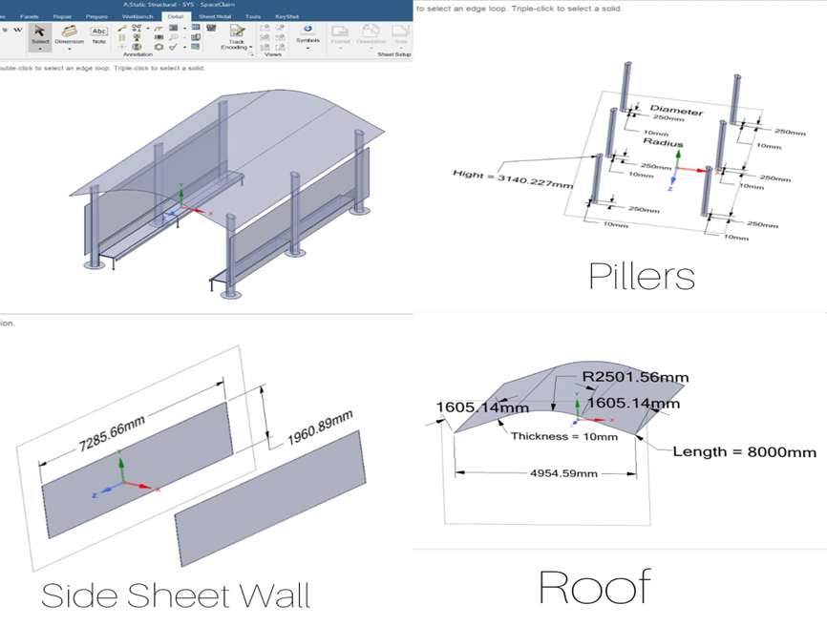
Repurposing Decommissioned Wind Turbine Blades for Sustainable Boat Waiting Shelters in Kerala
Name: Levin Robert
SCHOOL OF BUILT ENVIRONMENT, ENGINEERING AND COMPUTING
MSc Advanced Engineering Management
Supervisor: Dr, David Love
OVERVIEW
RESEARCH OUTCOME AND DISCUSSION
ETHICAL CONSIDERATIONS
The exponential growth of wind power throughout the globe has been accompanied by the urgency of managing end-of-life wind turbine blades. The blades, typically glass fiber-reinforced polymers (GFRP), are difficult to recycle due to their thermoset composite properties. The study proposes the innovative reuse of end-of-life wind blades in the building of boat waiting sheds in Kerala, India, addressing waste and infrastructural issues concurrently. By coupling structural and thermal simulations, this research evaluates the performance, feasibility, and sustainability of using these blades in coastal infrastructure development.
No human or animal testing was conducted. Environmental sustainability and responsible material sourcing were core ethical priorities. Stakeholder consent will be considered for pilot implementation.
Suitability in Kerala: The design withstands wind, sun, and monsoon rains. Its shape promotes rainwater runoff and wind deflection. UV-resistant coatings ensure longevity.
Comparison with Traditional Materials:
Durability: Blade outlasts steel and timber in tropical environments.
Thermal Comfort: Remains 15 °C cooler underneath than metal roofs.
Lifecycle Costs: Lower maintenance and replacement needs.
Environmental Impact: Diverts FRP from landfills, promotes reuse.
Challenges and Solutions:
Cutting and sealing require expertise.
Public policy and awareness needed to scale reuse.
Local adaptation possible with pilot projects.
Figure 1 - BladeBridge in Poland using 13m blade sections as beams (Brandon, 2022)
ACKNOWLEDGEMENTS
AIM AND OBJECTIVES
METHODOLOGY
This research was made possible with guidance from academic supervisors and access to software tools provided by the university.
Research Aim: To assess the feasibility of reusing decommissioned wind turbine blades as sustainable roofing for boat service shelters in Kerala.
Objectives:
Evaluate mechanical feasibility using simulation tools (ANSYS).
Develop CAD-based architectural design using SolidWorks.
Perform structural and thermal analysis.
Align with circular economy principles.
Propose a framework for policy integration and upscaling.
Design and CAD Modelling: A 9-meter GFRP blade section was integrated into a boat shelter design using SolidWorks. The blade acts as a curved canopy supported by GFRP columns.
Structural Analysis (ANSYS):
Static structural FEA simulated wind uplift (~0.6 kPa), gravity, and live loads.
Max displacement: 8.5 mm; Max von Mises stress: 34 MPa within safe GFRP limits.
Thermal Analysis (ANSYS):
Simulated solar exposure (800 W/m²).
Max surface temp: 52 °C; Inner surface: 36°C.
Demonstrated insulation and user comfort in hot climate.
Material Properties Used:
GFRP: E ≈ 30 GPa, ρ ≈ 2000 kg/m³, k ≈ 0.3 W/m·K
Steel: E ≈ 210 GPa
RATIONALE
REFERENCES
With an estimated 43 million tons of turbine blade waste expected by 2050 (Jensen & Skelton, 2018), repurposing offers an environmentally and economically sustainable alternative. In coastal Kerala, infrastructure like boat shelters faces rapid deterioration due to the tropical climate. This presents an opportunity to utilize durable GFRP blades, turning waste into long-lasting assets aligned with the UN Sustainable Development Goals.
Alshannaq, A. et al. (2021). Structural reuse of decommissioned wind blades. Bank, L. C. et al. (2017). Re-using composite wind turbine blades in infrastructure. Brandon, T. (2022). Re-Wind BladeBridge applications. Climate Data. (2025). Kerala weather profile. Gignac, J. et al. (2020). Mechanical recycling of FRP composites. Jensen, P. D. & Skelton, K. (2018). Forecasting blade waste to 2050. Lozanova, S. (2022). Challenges of wind blade end-of-life. Menezes, R. (2022). BladeMade reuse cases in the Netherlands. Sorte, T. et al. (2023). Pyrolysis and composite recycling studies. Strong, M. (2024). GFRP waste disposal practices. Wang, Y. et al. (2016). FRP blade stress modelling under wind loads.
LITERATURE REVIEW
GFRP and CFRP composite wind turbine blades consist of aerodynamic shells and load-carrying spars (Bank, L. C. et al., 2017). The materials are thermoset in nature, which poses problems in recycling with conventional techniques. Mechanical recycling, thermal treatment in the form of pyrolysis, and cement co-processing offer partial solutions but each with some constraints (Lozanova, 2022; Gignac et al., 2020).
Repurposing avoids these challenges by utilizing blades as architectural or structural components. Polish pedestrian bridges (Brandon, 2022), Dutch bus shelters (Menezes, 2022), and hypothetical housing in hurricane zones (Bank, L. C. et al., 2017) are just a few instances. Evidence confirms FRP durability in tropical and coastal regions with strong resistance to corrosion, UV degradation, and fatigue (Alshannaq et al., 2021; Wang et al., 2016).
CONCLUSION
Repurposing wind turbine blades in boat shelters combines sustainability with engineering innovation. The design met all structural and thermal performance criteria. It demonstrates how circular economy concepts can be turned into real-world infrastructure solutions. Policymakers, civil engineers, and designers should collaborate to scale up such reuse practices, particularly in climate-sensitive regions like Kerala.
Figure 2 - SolidWorks model of the proposed boat shelter design using a repurposed wind turbine blade. Key dimensions (in mm) are annotated.

Slide 2
Important Links :
Presentation link: https://youtu.be/hn2uJ2DaVho
Report link: https://github.com/levinrbrt/Report/blob/6bd6e06773895af75392730980c66f39e5c886bf/Repurposing%20Decommissioned%20Wind%20Turbine%20Blades%20for%20Sustainable%20Boat%20Waiting%20Shelters%20in%20Kerala.pdf
SolidWorks Model Link: https://github.com/levinrbrt/Dissertation/blob/64a3045ee85f9d25a93c51c2b88e7de9b58a37fd/First%202.IGS

